Slide 1

LAN Switching &
Wireless
CONFIGURE A SWITCH
Aoife Fox - Institute of Technology Blanchardstown
13-Oct-09

Slide 2

Objectives
• Summarize the operation of Ethernet as defined for
100/1000 Mbps LANs in the IEEE 802.3 standard.
• Explain the functions that enable a switch to forward
Ethernet frames in a LAN.
• Configure a switch for operation in a network designed
to support voice, video, and data transmissions.
• Configure basic security on a switch that will operate in
a network designed to support voice, video, and data
transmissions.

Slide 3
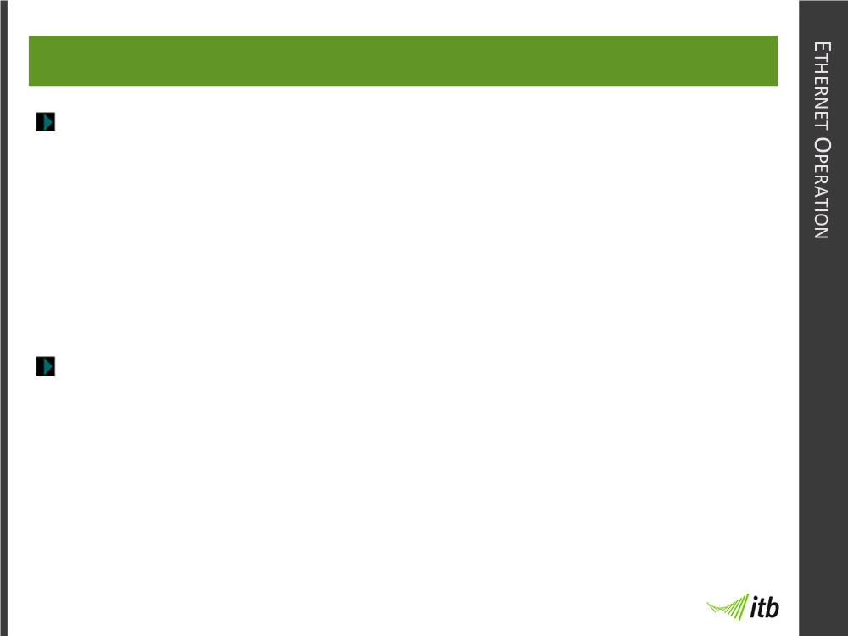
Ethernet Operation
You should understand how CSMS/CD works.
• Listening before transmit mode
• Collision detection
• Jamming signal
• Backoff Algorithm
CSMA/CD only operates in half duplex environment.

Slide 4
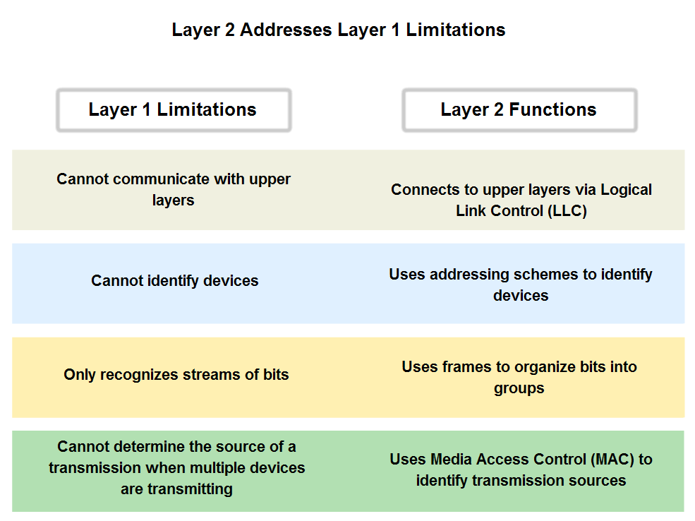
Quick Recap

Slide 5
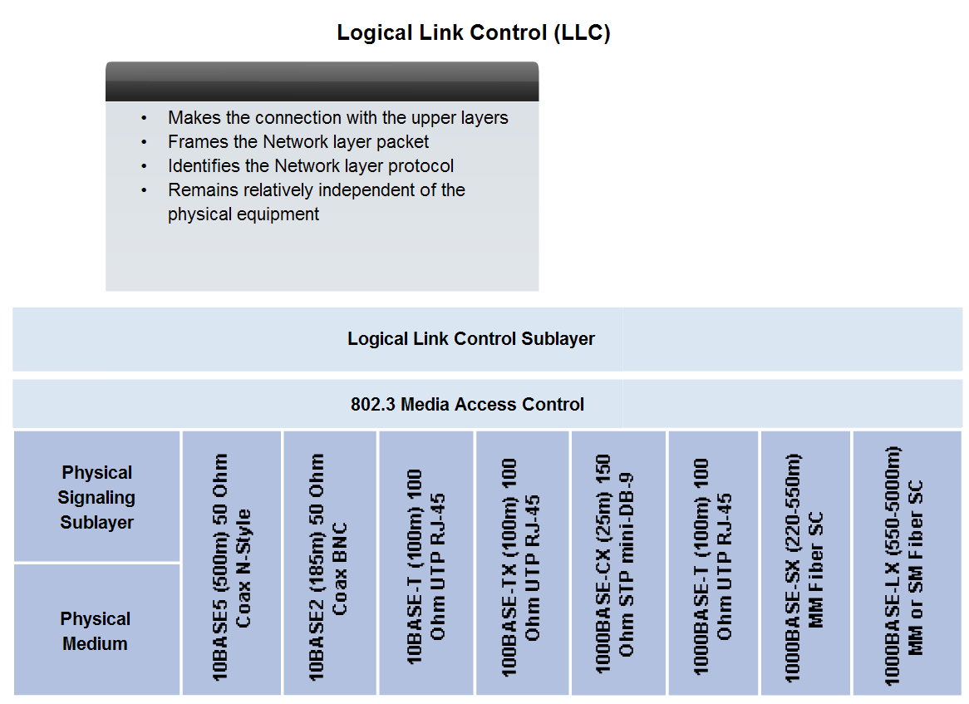
LLC and MAC Layers

Slide 6
Carrier Sense and Multiple Access
Carrier Sense: In the CSMA/CD access method, all network devices that have messages to send must listen before transmitting. If a device detects a signal from another device, it will wait for a specified amount of time before attempting to transmit.
Multiple-access: If the distance between devices is such that the latency of one device's signals means that signals are not detected by a second device, the second device may start to transmit, too. The media now has two devices transmitting their signals at the same time. Their messages will propagate across the media until they encounter each other.

Slide 7
Collision Detection
3. Collision Detection: When a device is in listening mode, it can detect when a collision occurs on the shared media. The detection of a collision is made possible because all devices can detect an increase in the amplitude of the signal above the normal level.
4. Jam Signal: Once the collision is detected by the transmitting devices, they send out a jamming signal. This jamming signal is used to notify the other devices of a collision, so that they will invoke a backoff algorithm.
This backoff algorithm causes all devices to stop transmitting for a random amount of time, which allows the collision signals to subside.

Slide 8
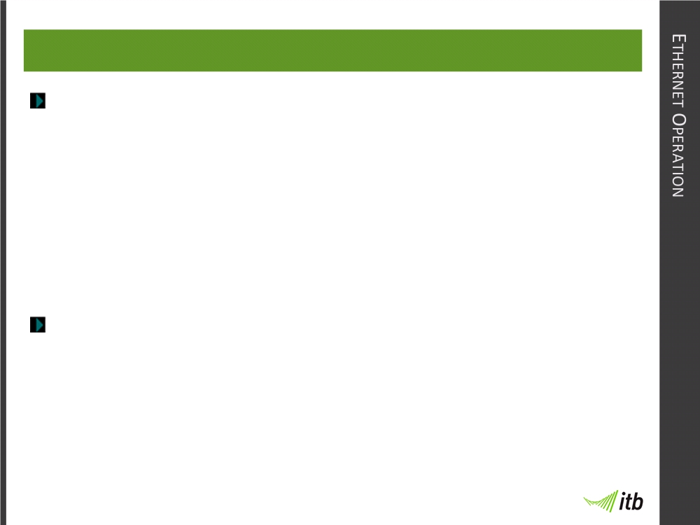
13-Oct-09
Half Duplex and Full Duplex
Half Duplex:
• data sent in only one direction at a time, either
sending or receiving.
• Typically uses CSMA/CD because collisions
occur.
• Hubs operate using half duplex.
Full Duplex:
• Data sent in both directions at same time.
• No collisions occur.
• Switches prefer to operate in full duplex mode.

Slide 9
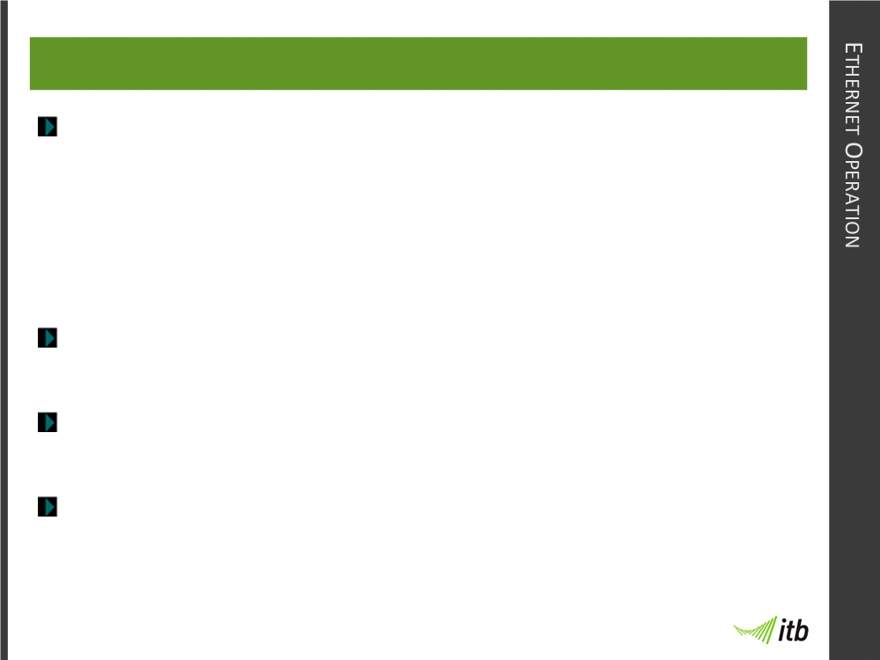
13-Oct-09
Switchport Settings
Cisco switches support three modes of operation:
• Auto:
Sets auto negotiation of duplex mode.
• Full:
Sets full duplex mode.
• Half:
Sets half duplex mode.
Auto negotiation can cause unpredictable results.
Ensure same mode at either end to avoid errors.
Can also use auto-MDIX feature on newer switches
(enables auto sensing of cable types)

Slide 10
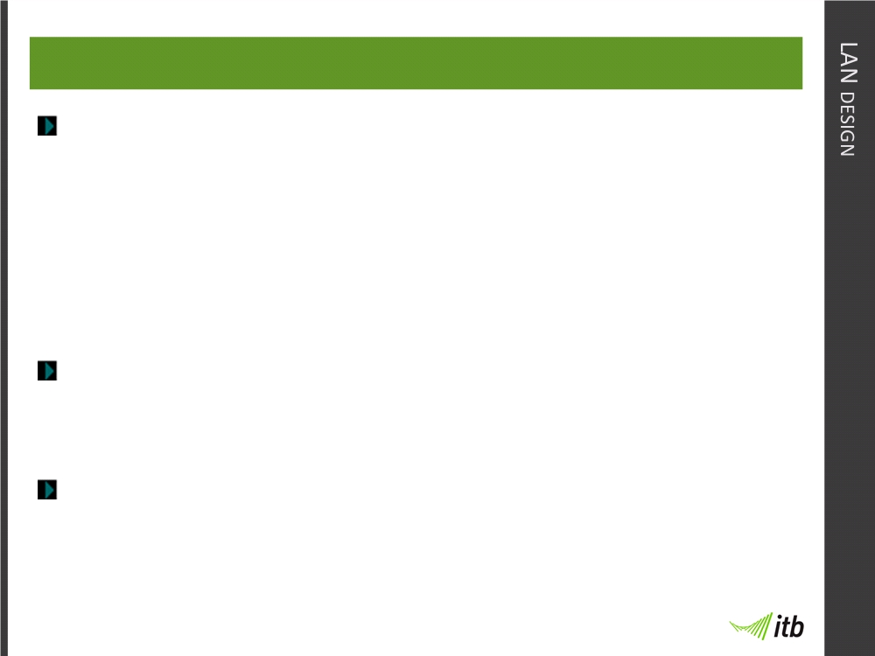
13-Oct-09
LAN Design
Proper LAN design uses segmentation to reduce LAN
performance problems such as:
• Collisions
• Latency
• Congestion
Smaller collision domains and broadcast domains =
better network performance.
Switches introduce less latency than routers and are the
main device used to create smaller collision domains.

Slide 11
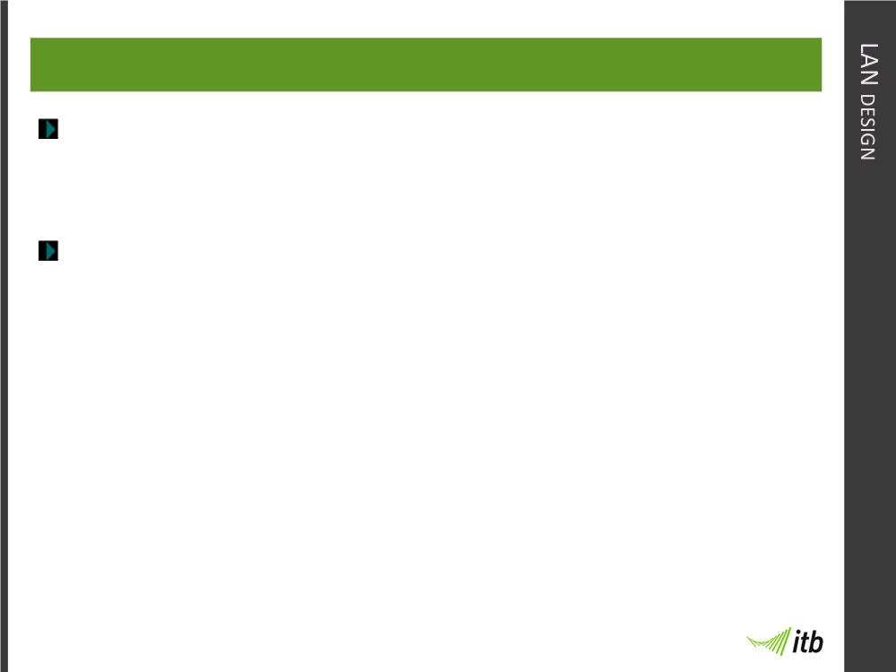
13-Oct-09
LAN Design
Routers and VLANs can help reduce size of broadcast
domains.
You should understand broadcast and collision
domains.

Slide 12
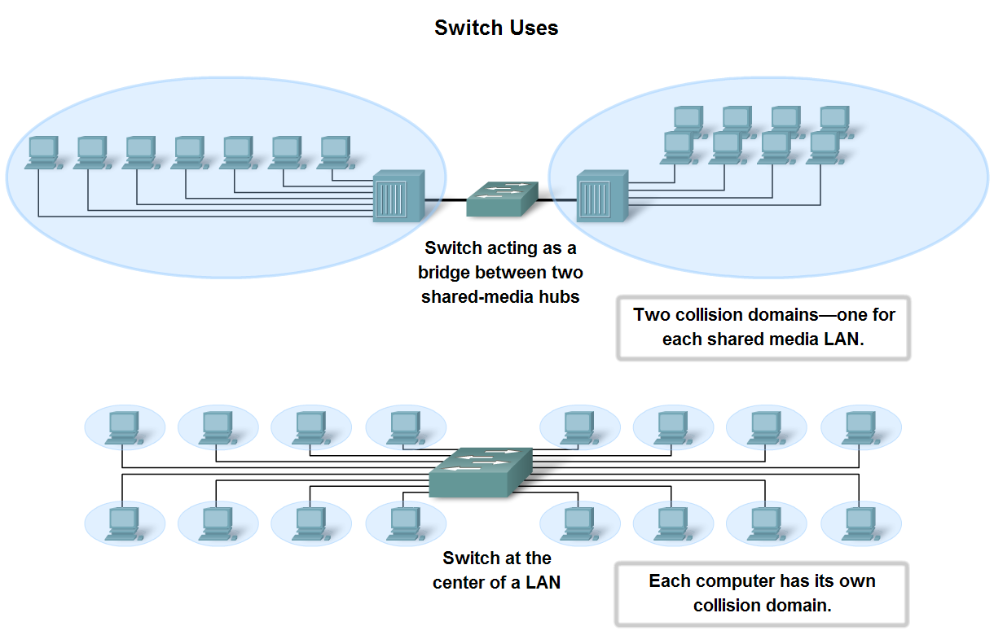
13-Oct-09
LAN Design

Slide 13
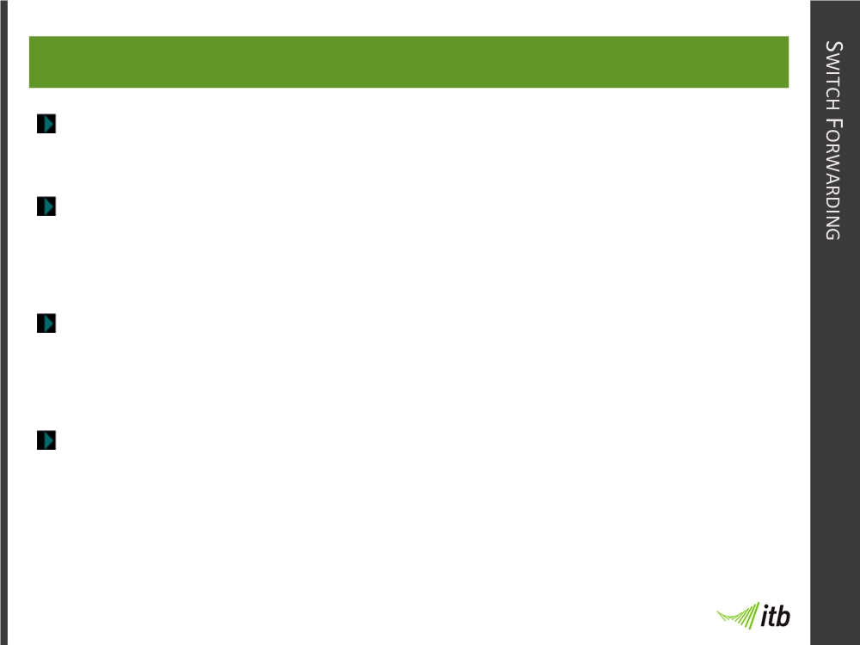
13-Oct-09
Switch Forwarding
Switches use MAC addresses to direct Frames.
Source MAC address of incoming frame is added to
MAC address table (or CAM table).
Destination MAC address of incoming frame compared
to CAM table to decide which port to forward frame out.
Addresses not found in CAM table are forwarded out
all other ports (switch acts like a hub).

Slide 14
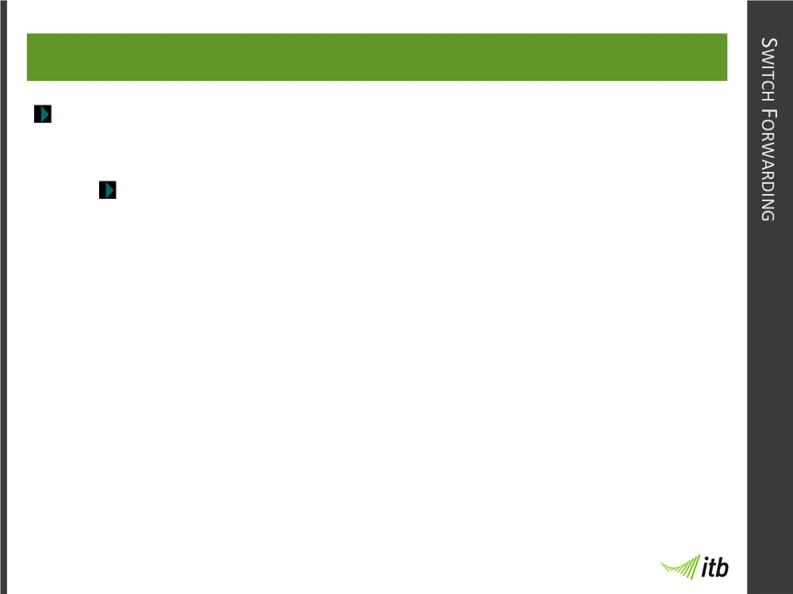
13-Oct-09
Switch Forwarding Methods
Switches use one of two methods for switching data.
Store-and-forward:
• Only method currently used by Cisco switches
• Complete frame is stored in buffer
• Performs error checking on CRC
• Frames with errors are dropped
• Traffic prioritisation (Converged networks)
• Quality of service (Converged networks)

Slide 15
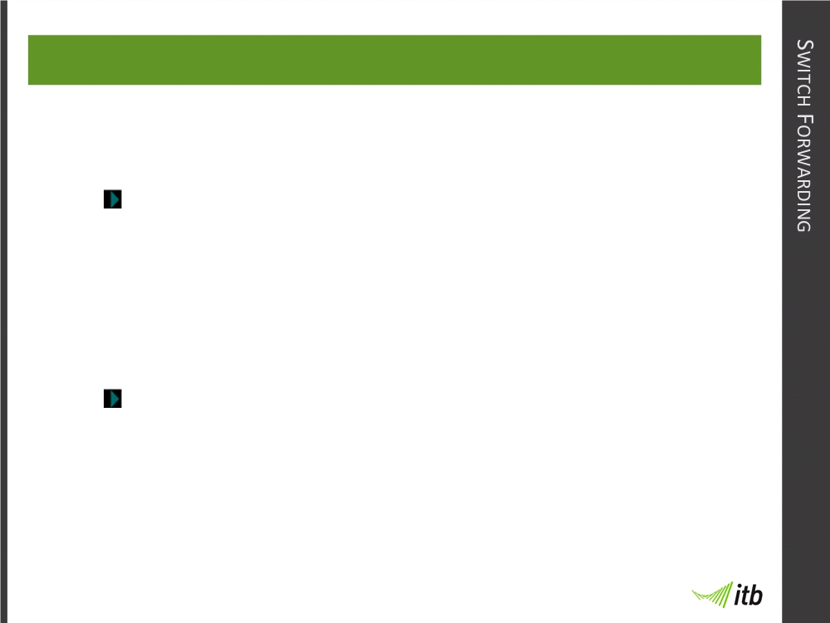
13-Oct-09
Switch Forwarding Methods
Cut-through: (Two variations)
Fast-forward switching:
• Fastest forwarding method
• Reads just the destination before forwarding
• No error checking, corrupt frames forwarded
Fragment-free switching:
• First 64 bytes stored
• Partial error check
• Compromise between previous two methods

Slide 16
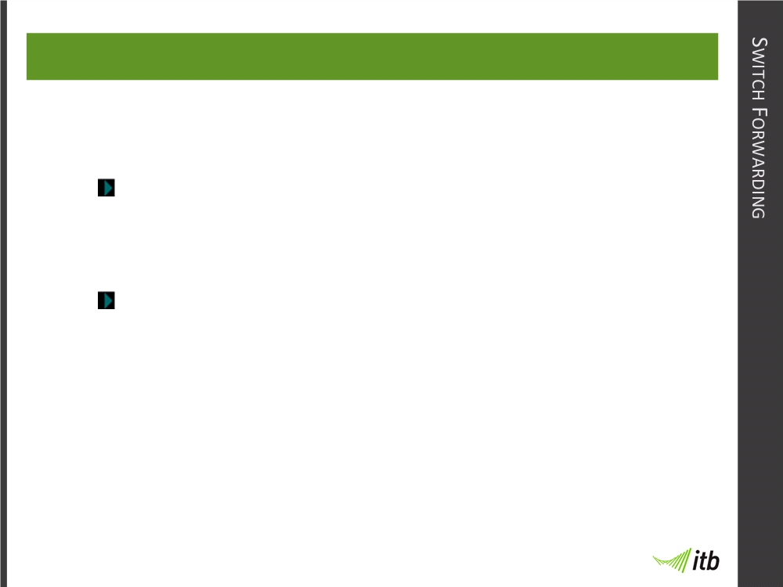
13-Oct-09
Symmetric and Asymmetric Switching
A switch can be classified as:
Symmetric:
• All ports use the same bandwidth.
Asymmetric:
• Ports can be different bandwidths.
• Applies to most Cisco switches.
• Memory buffering is required.

Slide 17
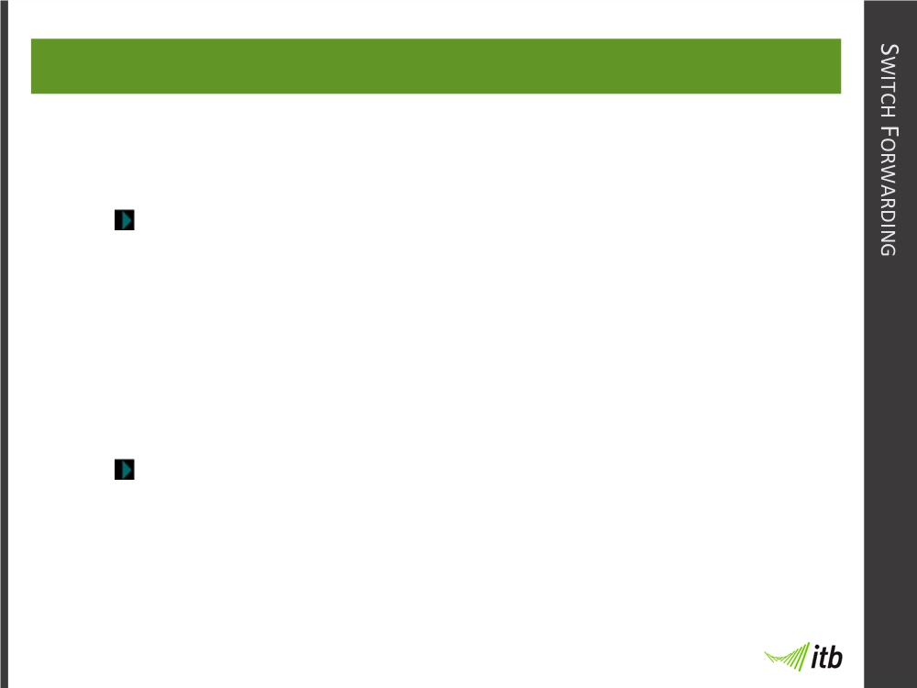
13-Oct-09
Memory Buffering
There are two methods of memory buffering:
Port-based:
• Frames stored in queues based on incoming
port.
• Frame only sent if all frames before it have
been transmitted.
Shared memory:
• All frames stored in common memory area
• Less frames trapped behind a large frame

Slide 18
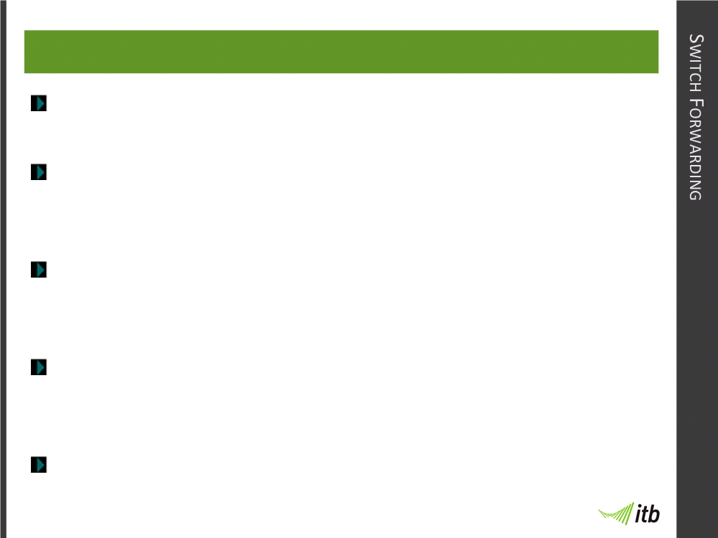
13-Oct-09
Layer 2 and Layer 3 switching
Switches can be layer 2 or layer 3 switches.
Layer 3 switches can perform layer 3 tasks like IP
filtering and access control.
Layer 3 switches can remove the need for a router in
the LAN.
There are some tasks that layer 3 switches cannot do,
for which a router is still required.
Layer 3 devices, higher latency than layer 2 devices

Slide 19
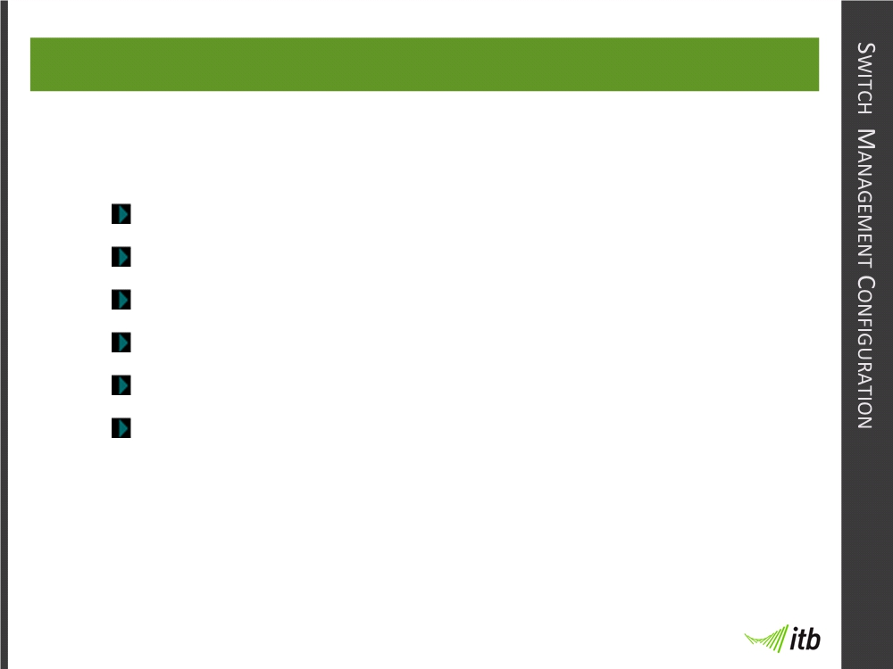
13-Oct-09
Switch Management Configuration
You should be familiar with all the basic CLI commands:
User & Privileged (enable) mode
Command syntax help
Passwords
Hostnames
Descriptions
Boot sequence and file locations
All of these are similar for both switches and routers

Slide 20
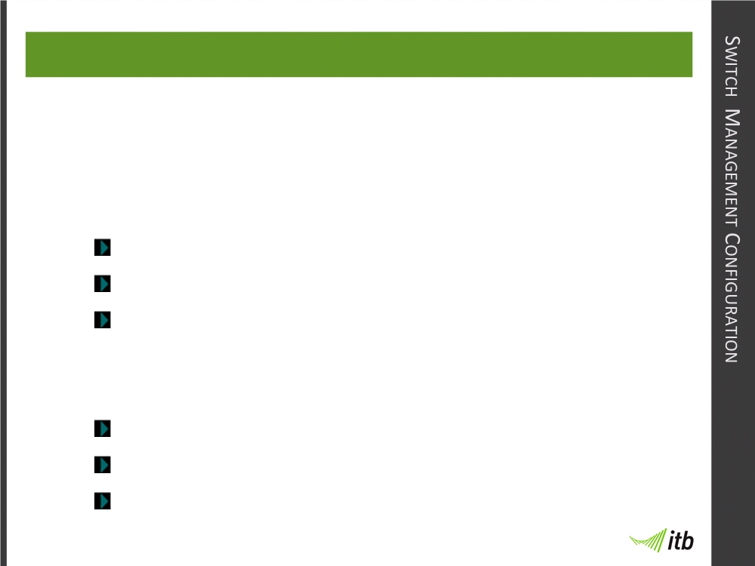
13-Oct-09
Management Interface
To manage a switch remotely using TCP/IP you need
to set up the management interface on the switch.
To set up the management interface, you need to:
Create a management VLAN
Assign management VLAN to a port
Set the IP address
Other options that you should also set include:
Default Gateway address
Duplex and speed of interfaces
HTTP access

Slide 21
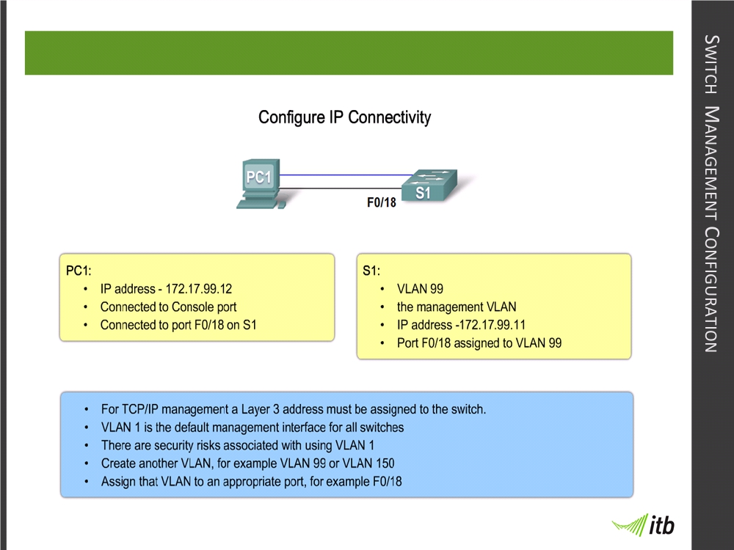
13-Oct-09
Management Interface

Slide 22
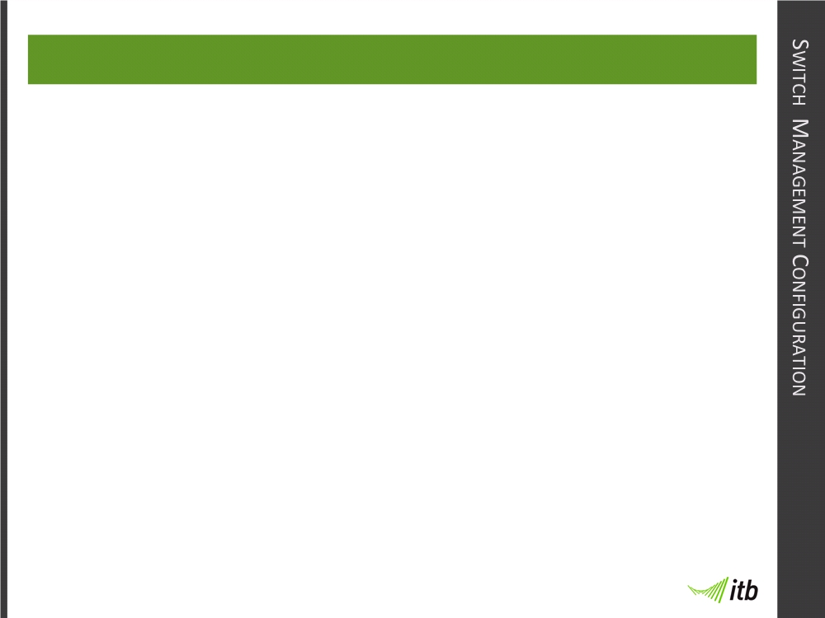
13-Oct-09
Management Interface
All of the basic commands covering
how to set up the management
interface and managing the switch
will be covered in the labs and are
not covered by these notes

Slide 23
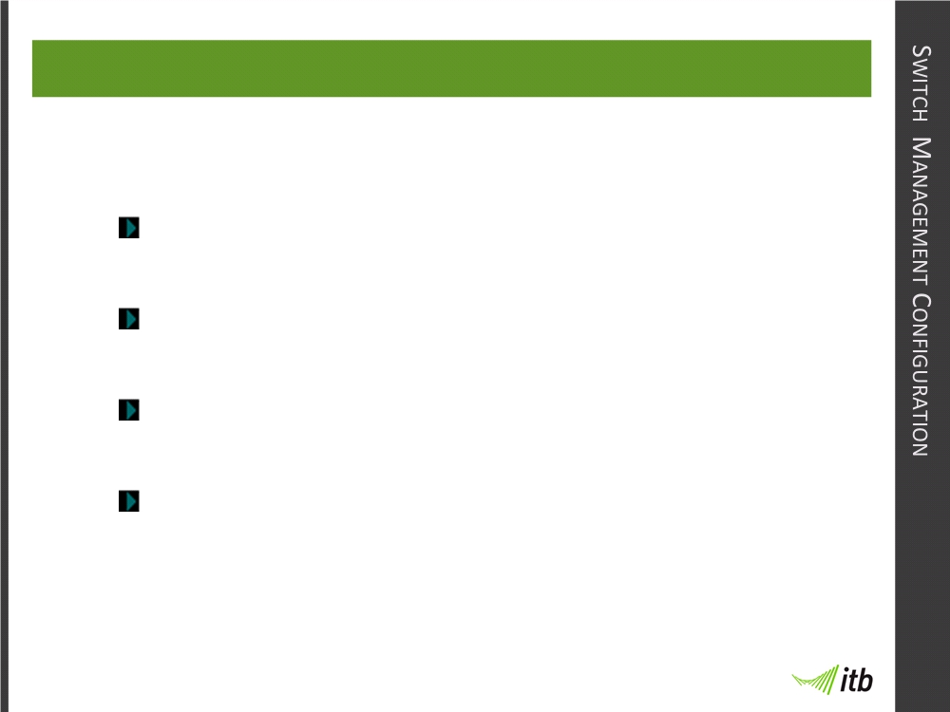
13-Oct-09
Configuring Switch Security
Telnet is the original remote terminal access program
All messages are sent in plain text
It is the default vty supported protocol on Cisco
Default access is unsecured
Set vty password to set telnet password

Slide 24
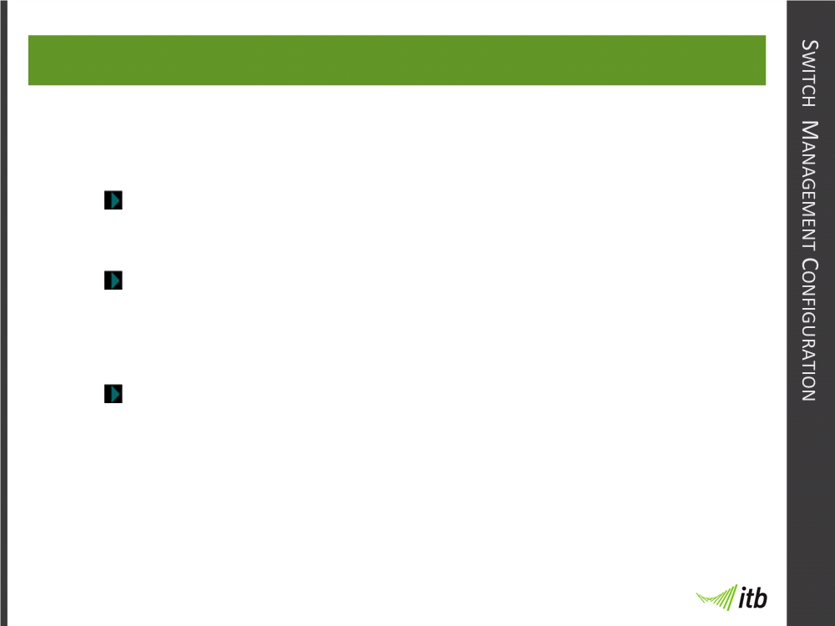
13-Oct-09
Configuring Switch Security
SSH is a secure alternative to telnet
All messages are encrypted
SSHv1 and SSHv2 are supported (use v2 where
possible)
Need to generate RSA keys

